Slide 1

Dept. of Computer Science and Engineering BRAC University CSE 341 Team
8086 Flag Register

Slide 2
Lecture References:
Book:
Microprocessors and Interfacing: Programming and Hardware, Chapter # 2, Author: Douglas V. Hall

Slide 3
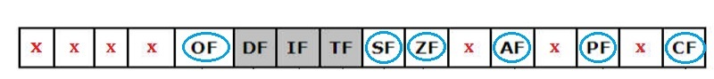
8086 Flag Register
16-Bit register
7 bits are undefined/unused (marked by red x in the figure below)
6 status/condition flags (marked by blue circles)
3 control flags (those in grey boxes)
The condition flags are set (1) or reset (0) depending on the result of an arithmetic/logical operation.
Control flags control the operations of the CPU
Bit Positions
15 14 13 12 11 10 9 8 7 6 5 4 3 2 1 0

Slide 4
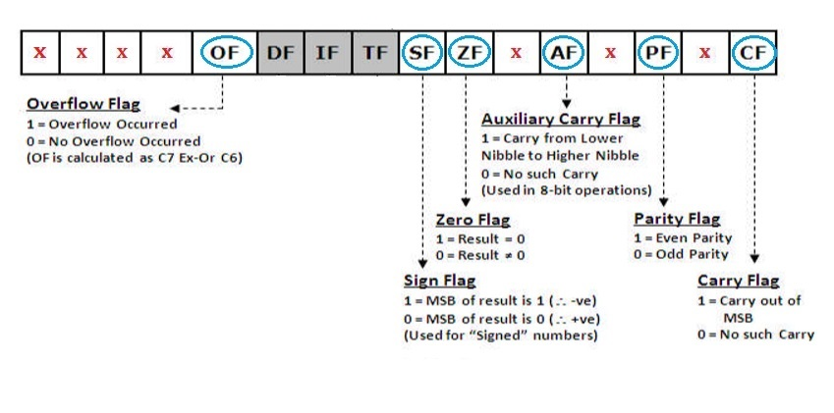
Status Flags
Flags are useful in programming e.g. when writing conditions such as:
If answer is zero, do … else …. // zero flag comes in hand here
If answer is less than zero, do … else …. // sign flag can be used here

Slide 5
Status Flags
Carry Flag (CF) - is set to ’1’ when there is an unsigned overflow. E.g. when you add bytes 255 + 1 (result is not in range 0...255). When there is no overflow this flag is reset to 0.
Parity Flag (PF) - set to ’1’ when there is even number of one bits in result, and reset to ’0’ when there is odd number of one bits. Even if result is a word only lower 8 bits are analyzed!
Auxiliary Flag (AF) - set to ’1’ when there is an unsigned overflow for low nibble (4 bits).

Slide 6
Status Flags
Zero Flag (ZF) - set to ’1’ when result is zero. For non-zero result this flag is reset to ’0’.
Sign Flag (SF) - set to ’1’ when result is negative. When result is positive it is reset to ‘0’. (This flag takes the value of the most significant bit).
Overflow Flag (OF) - set to ’1’ when there is a signed overflow. For example, when you add bytes 100 + 50.

Slide 7
Status Flags
NB:
OF is set to 1 if there is a carry from:
the 7th bit to the 8th bit ONLY or
from the 8th bit to the 9th bit ONLY
If there is a carry from the 7th bit to the 8th bit and from the 8th bit to the 9th bit at THE SAME TIME then OF = 0
OF=1
Set because there is a carry from the 7th bit to the 8th bit ONLY
AF=0
Reset because there is NO carry from the lower nibble to the upper nibble
Carry 1 1 1
MOV AL, 50
MOV BL, 32
ADD AL, BL
MOV AL, 50h ( 0 1 0 1 0 0 0 0 )
MOV BL, 32h ( 0 0 1 1 0 0 1 0 )
ADD AL, BL
( 1 0 0 0 0 0 1 0 )
x
ZF=0
Reset because the answer is NOT zero
PF=1
Set because the answer has an EVEN number of 1s
CF=0
Reset because the answer has NO carry
SF=1
Set because the MSB is 1 indicating a negative answer

Slide 8
Status Flags
NB:
OF is reset to 0 if:
there is a carry from the the 7th bit to the 8th bit and from the 8th bit to the 9th bit at THE SAME TIME or
there is NO carry from the the 7th bit to the 8th bit and from the 8th bit to the 9th bit at THE SAME TIME
OF=0
Reset because there is a carry from the 7th bit to the 8th bit and from the 8th bit to the 9th bit at THE SAME TIME
Carry 1 1 1 1 1 1 1 1
AF=1
Set because there IS a carry from the lower nibble to the upper nibble
MOV AL, FFh 1 1 1 1 1 1 1 1
MOV BL, 01h 0 0 0 0 0 0 0 1
ADD AL, BL
1 0 0 0 0 0 0 0 0
ZF=1
Set because the answer IS zero
PF=1
Set because the answer has an EVEN number of 1s
CF=1
Set because the answer has a carry
SF=0
Reset because the MSB is 0 indicating a positive answer

Slide 9
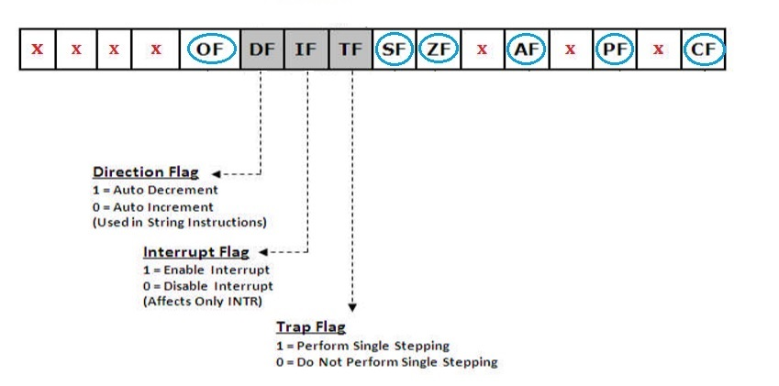
Control Flags:

Slide 10
Control Flags:
Trap Flag (TF) - Used for on-chip single-step debugging.
Interrupt enable Flag (IF) - when this flag is set to ’1’ CPU reacts to interrupts from external devices.
Direction Flag (DF) - this flag is used by some instructions to process data chains, when this flag is set to ’0’ - the processing is done forward, when this flag is set to ‘1’ the processing is done backward.

Slide 11
Quiz: Status Flag Values?
MOV AX, ABCDh
MOV BX, 9876h
ADD AX, BX

Slide 12
Thank You !!

